Slide 1
Unspeakable Things Unspoken: The Afro-American Presence in American Literature
Toni Morrison
By Natalya Bennett

Slide 2
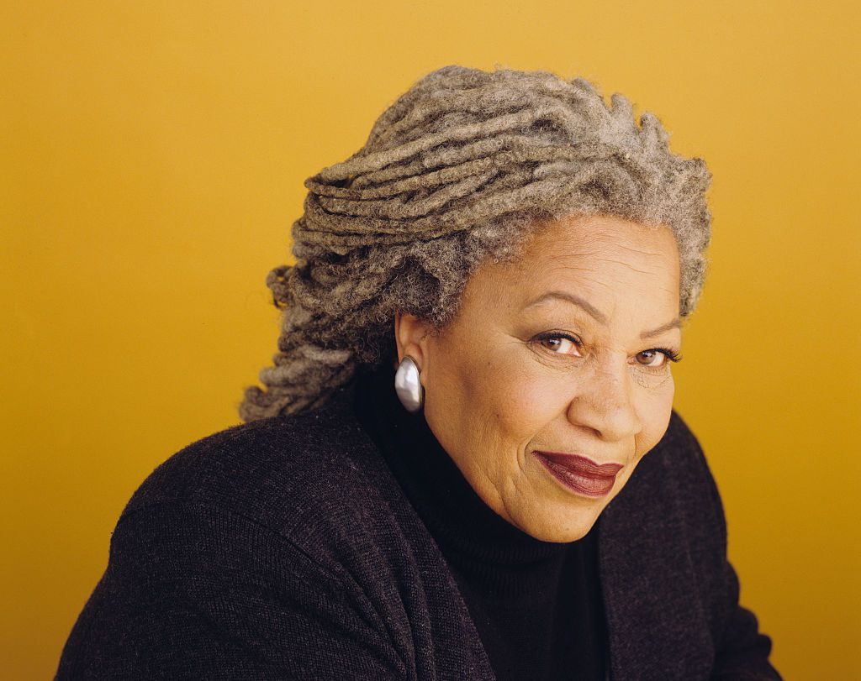

Slide 3
About Morrison
Born in Lorain, OH, 1931; currently 88 years old.
Novelist, editor and professor.
Nobel Prize and Pulitzer Prize-winning American novelist.
Writing includes African-Americans as central to text.
Best known novels:
The Bluest Eye (1970), confront internalized racism, African American main character aspires to have blue eyes.
Beloved (1987), examine the destructive legacy of former slave.
“If there is a book that you want to read, but it hasn't been written yet, you must be the one to write it”.
-Toni Morrison
Notes:
Born February 8, 1931.
Author of various novels.

Slide 4
Published in The Tanner Lectures on Human Values(1988), a collection of lecture published in annual volumes.
Essay examines what “constitutes a literary canon in order to suggest ways of addressing the Afro-American presence in American literature”(123).
Unspeakable Things Unspoken: The Afro-American Presence in American Literature
“Canon Fodder”
Notes:
Questions: Does Afro-American lit fit in?
American literature is somehow separate from Afro-American literature.
Afro-American literature will never be canonized if critics continue to preserve the literary preferences of white men only.

Slide 5
The Quality of Greatness
What use is it going on about “quality” being the only criterion for greatness knowing that the definition of quality is itself the subject of much rage and is seldom universally agreed upon by everyone at all times?”(125)
Problem: Literary critics and scholar use quality as the basis for superior literature.
Solution: Stop attempting to define what is considered quality and who is able to create it.

Slide 6
Greek Tragedy and African American Literature
Greek tragedy feels like home
Greek tragedy similar to communal structures in Afro-American literature, religion and philosophy.
I.e. Function of song and chorus, heroic struggle

Slide 7
No Race in Canonization
Race does not exist.
Race is not a distinguishing factor in human relationships.
Afro-American culture exist, however it is not yet understood how Afro-American culture has responded to or shaped Western culture.
Previously, academic disciplines such as, theology, history and natural science claimed race was the determining factor in human development.
Notes:
When Black discovered they had become a culturally formed race---Constructs of race only useful to its creators when convenient, no longer convenient.

Slide 8
Silencing the Autonomy of Afro- Literature
Four Charges Against Afro-Literature:
There is no Afro-American literature.
Afro-American art exist, but is inferior.
Afro-American art exist, but is superior only when it measures up to the universal criteria of Western art.
Afro-American art is worthy, because it is raw and rich, like ore, and like ore needs refining by Western intelligences.

Slide 9
Portrayals in Canonical Texts
Challenging the meaning in Herman Melville’s, Moby Dick:
The white whale depicts American Slavery and the ideology of race/Seen as analogy for oppression of African Americans.
Melville uses this as a stand against slavery.

Slide 10
The End

